Slide 1
Graph Attention Networks lecture-9 Course on Graph Neural Networks (Winter Term 21/22)
Prof. Dr. Holger Giese (holger.giese@hpi.de)
Christian Medeiros Adriano (christian.adriano@hpi.de) - “Chris”
Matthias Barkowski (matthias.barkowski@hpi.de)

Slide 2
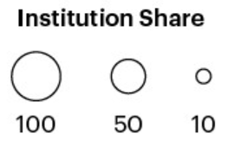
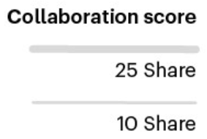
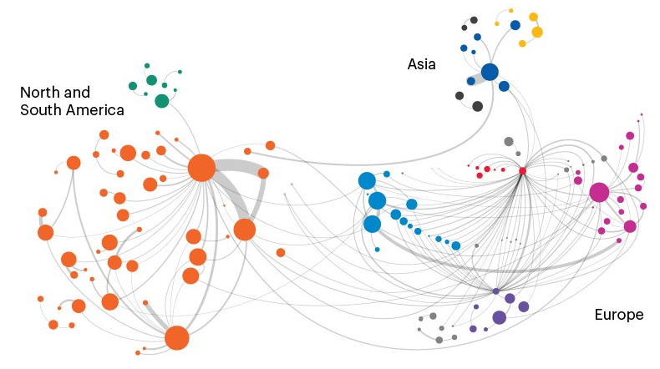
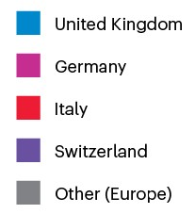
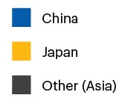
Network effect – AI connections in Natural Sciences
National Institute Of Nuclear Physics
Harvard
UC San Francisco
Max Planck Society
MIT
UC Berkely
Helmholtz Association of German Research Centers
UC Los Angeles
CERN
Stanford
Network effect: visualizing AI connections in the natural sciences, 2020
https://www.nature.com/articles/d41586-020-03410-1

Slide 3
Quick recap
Metrics
Classification
Random Walks
Node and Graph Embeddings
PageRank
Graph Structure Learning
Graph Convolutional Networks
2014 - Computer Vision allow to highlight important parts of the image that contribute most to the desired output [Bahdanau et al. 2014] [Wang & Tax 2016]
2015 – Aligned Machine Translation (allow decoder to peek at the input of the decoder) [Luong et al. 2015][Xu et a. 2015]
2017 – Language Modeling with Transformer Networks
“Attention is all you need” [Vaswani et al. 2017]
Why do we need Graph Attention Networks?
We need a way to scale without having to make large random walks in the graph
The “Attention” approach allows us to:
Decide which parts of the input we should focus most on
Better allocate the limited processing resources to the most important parts
Notes:
[Wang & Tax 2016] Wang, Feng, and David MJ Tax. "Survey on the attention based RNN model and its applications in computer vision." arXiv preprint arXiv:1601.06823 (2016).
[Luong et al. 2015] Luong, Minh-Thang, Hieu Pham, and Christopher D. Manning. "Effective approaches to attention-based neural machine translation." arXiv preprint arXiv:1508.04025 (2015).
[Vaswani et al. 2017] Vaswani, A., Shazeer, N., Parmar, N., Uszkoreit, J., Jones, L., Gomez, A. N., ... & Polosukhin, I. (2017). Attention is all you need. Advances in neural information processing systems, 30, 5998-6008.
Bahdanau, Dzmitry, Kyunghyun Cho, and Yoshua Bengio. "Neural machine translation by jointly learning to align and translate." arXiv preprint arXiv:1409.0473 (2014).
Xu, Kelvin, et al. "Show, attend and tell: Neural image caption generation with visual attention." International conference on machine learning. 2015.
The research described in the paper Graph Convolutional Network (GCN), indicates that combining local graph structure and node-level features produces good performance on node classification tasks. However, the way GCN aggregates is structure-dependent, which can hurt its generalizability.
One workaround is to simply average over all neighbor node features as described in the research paper GraphSAGE. However, Graph Attention Network proposes a different type of aggregation. GAN uses weighting neighbor features with feature dependent and structure-free normalization, in the style of attention.

Slide 4
Attention history
[Bahdanau et al 2014] allowed their RNN model give particular attention to certain hidden states when decoding each word. This way they allowed the model to learn which words to give
attention to and which ones to ignore while translating of each word at the decoder.
[Bahdanau et al 2014] Bahdanau, D., et al. 2014, "Neural machine translation by jointly learning to align and translate." arXiv preprint arXiv:1409.0473.

Slide 5
Topics
Introduction to Attention Models
Graph Attention Models (GAT)
Attention Models in Transformer Networks (Self-Attention)

Slide 6
Overview of Attention Models

Slide 7
Intuition for the need of attention
Take these two sentences from the Winograd Schema Challenge set:
1- The city councilmen refused the demonstrators a permit because they feared violence.
2- The city councilmen refused the demonstrators a permit because they advocated violence.
in 1, "they" is councilmen, while in 2, "they" is demonstrators.
Attention allows to determine if "they" is councilmen or demonstrators.
In the machine translation case, we call it self-attention.
[1] https://en.wikipedia.org/wiki/Winograd_Schema_Challenge

Slide 8
Motivation for Transformer Networks
Challenges with Recurrent Neural Networks
Long range dependencies
Vanishing gradient
Gradient explosion
Large number of training steps
Recurrence prevent parallel computation
Advantages of Transformer Networks
Facilitates long range dependencies
No Vanishing gradient
No Gradient explosion
Fewer number of training steps
No Recurrence, so facilitates parallel computation
h_{t}
h_{t}
h₀
h₁
h_{t}
F
F
EDA
A
A
A
A
x_{t}
SA
SA
x_{t}
x_{o}
x₁
x_{t}
Encoder
Decoder
Notes:
https://wiki.pathmind.com/lstm#two
https://colah.github.io/posts/2015-08-Understanding-LSTMs/

Slide 9
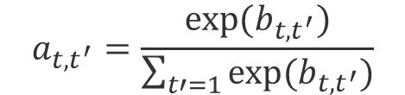



Attention
What is the amount of attention $a_{t,t^{′}}$ that the learning should have on pairs (or groups) of the input data $a_{t^{′}}$?
$$a_{t}$$
$$b_{{t,t}^{′}}$$
$$a_{t,t^{′}}=\frac{exp⁡(b_{t,t^{′}})}{\sum_{t′=1}{exp⁡(b_{t,t^{′}})}}$$
$$a_{t^{′}}$$
Attention Model
The attention mechanism will allow me to decide which parts of the input the learning algorithm will should focus next.

Slide 10
Example
Take three vectors (Query, Key, and Value) that embeddings of sentences
Example:
Query: S_{j} (a hidden vector for i^{th} output word)
Key= h_{j} (a hidden vector for j^{th} input word)
Value: h_{j} (a hidden vector for the j^{th} input word)
Translation
The attention mechanism will allow me to decide which are the words that I am interested in translating next.
Question&Answers
The attention mechanism allows to decide which answers should be match against a question

Slide 11
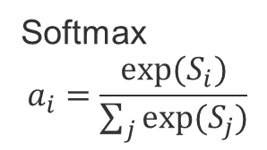
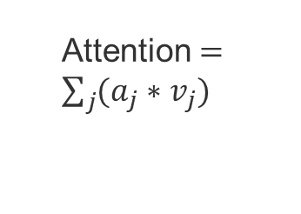
Attention Mechanism steps
v₁
v₂
v_{t}
The Query, Keys, and Values are vectors.
Example:
Query, keys, and values are embeddings
Query: S_{j} (a hidden vector for i^{th} output word)
Key= k_{j} (a hidden vector for j^{th} input word)
Value: h_{j} (a hidden vector for the j^{th} input word)
The attention mechanism will allow me to decide which are the words that I am interested in translating next.
Attention $=\sum_{j}{(a_{j}∗v_{j})}$
Step-3
Step-2
a₁
a₂
a_{t}
Softmax
$$a_{i}=\frac{exp⁡(S_{i})}{\sum_{j}{exp⁡(S_{j})}}$$
Step-1
S₁
S₂
S_{t}
k₁
k₂
k_{t}
q
Notes:
Step-1: Compute similarities
Step-2: Compute the alpha parameters (linear combination of Similarities)
Step-3: Compute the attention value

Slide 12
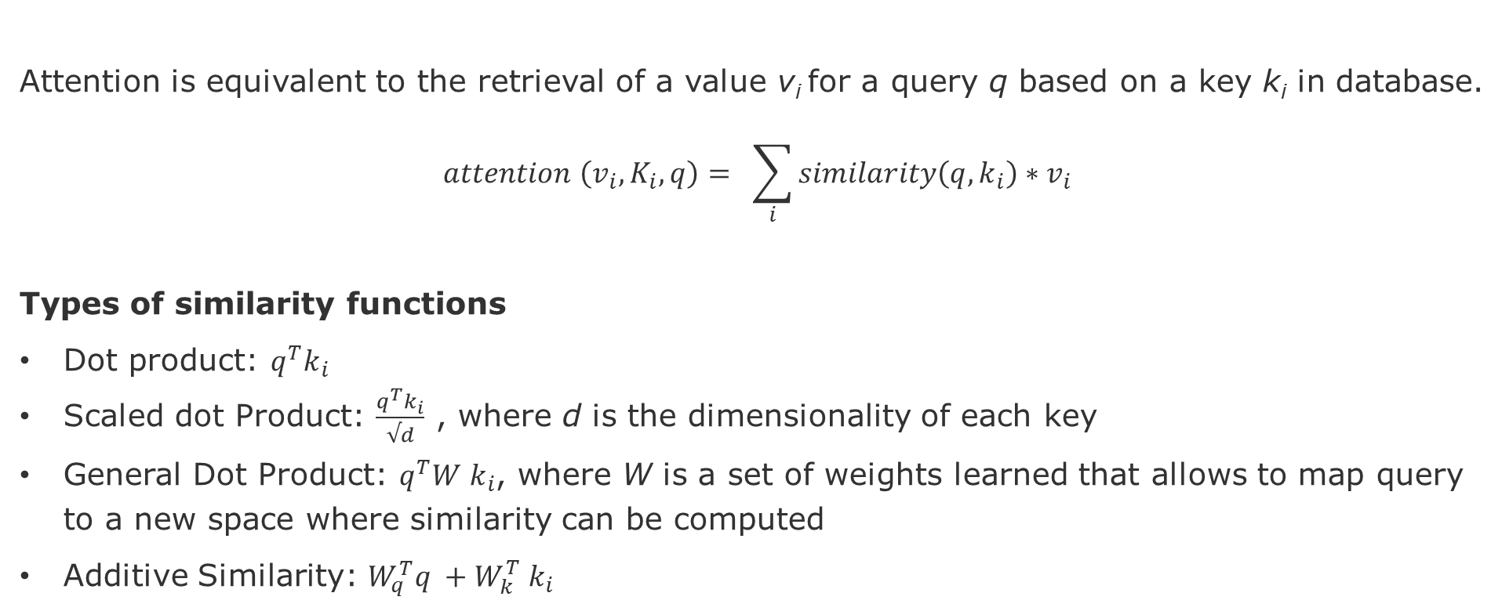
Attention
Attention is equivalent to the retrieval of a value v_{i} for a query q based on a key k_{i} in database.
$$attention \left(v_{i}, K_{i}, q\right)= \sum_{i}{similarity\left(q,k_{i}\right)}∗v_{i}$$
Types of similarity functions
Dot product: $q^{T}k_{i}$
Scaled dot Product: $\frac{q^{T}k_{i}}{√d}$ , where d is the dimensionality of each key
General Dot Product: $q^{T}{W k}_{i}$, where W is a set of weights learned that allows to map query to a new space where similarity can be computed
Additive Similarity: ${W_{q}^{T}q}^{ }+{W_{k}^{T} k}_{i}$

Slide 13
Attention in Graph Neural Networks

Slide 14
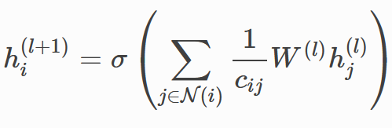
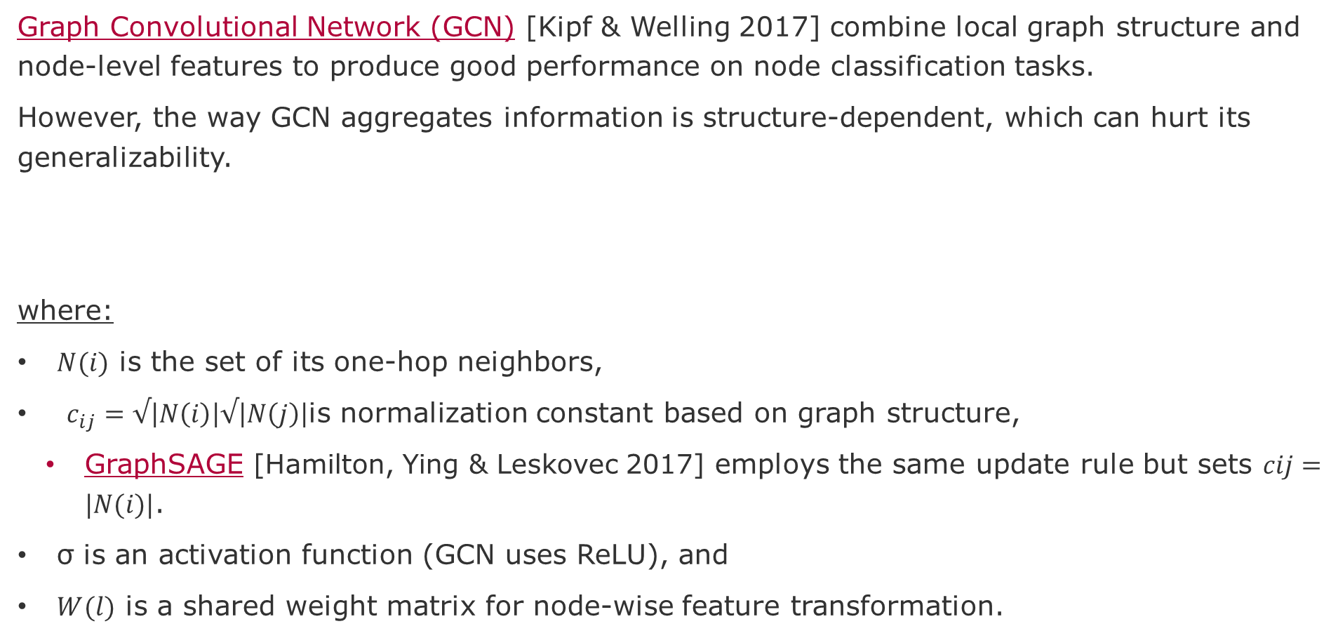
Recap GCN and GraphSage
Graph Convolutional Network (GCN) [Kipf & Welling 2017] combine local graph structure and node-level features to produce good performance on node classification tasks.
However, the way GCN aggregates information is structure-dependent, which can hurt its generalizability.
where:
$N(i)$ is the set of its one-hop neighbors,
$c_{ij}=√\left|N\left(i\right)\right|√\left|N\left(j\right)\right|$is normalization constant based on graph structure,
GraphSAGE [Hamilton, Ying & Leskovec 2017] employs the same update rule but sets $cij=|N(i)|$.
σ is an activation function (GCN uses ReLU), and
$W(l)$ is a shared weight matrix for node-wise feature transformation.
Notes:
[Kipf & Welling 2017] Kipf, Thomas N., and Max Welling. "Semi-supervised classification with graph convolutional networks." arXiv preprint arXiv:1609.02907 (2016).
[Veličković et al. 2017] Veličković, P., Cucurull, G., Casanova, A., Romero, A., Lio, P., & Bengio, Y. (2017). Graph attention networks. arXiv preprint arXiv:1710.10903.
[Hamilton, Ying & Leskovec 2017] Hamilton, Will, Zhitao Ying, and Jure Leskovec. "Inductive representation learning on large graphs." Advances in neural information processing systems. 2017.

Slide 15
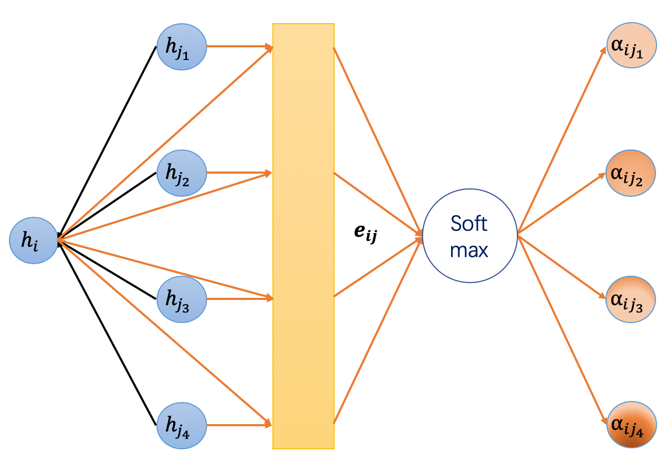
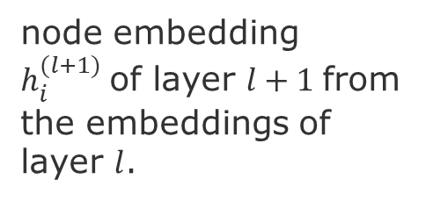
Graph Attention Network (GAT) [Veličković et al. 2018]
Graph Attention Network (GAT) proposes a different type of aggregation.
GAT uses the attention mechanism as a substitute for the statically normalized convolution operation.
weighting neighbor features + feature dependent and structure-free normalization
node embedding $h_{i}^{(l+1)}$of layer $l+1$from the embeddings of layer $l$.
Attention weights
Source: https://docs.dgl.ai/en/0.4.x/tutorials/models/1_gnn/9_gat.html
Notes:
[Veličković et al. 2018] Veličković, P., Cucurull, G., Casanova, A., Romero, A., Lio, P., & Bengio, Y. (2017). Graph attention networks. Advances in neural information processing systems. 2018.
[Kipf & Welling 2017] Kipf, Thomas N., and Max Welling. "Semi-supervised classification with graph convolutional networks." arXiv preprint arXiv:1609.02907 (2016).
[Hamilton, Ying & Leskovec 2017] Hamilton, Will, Zhitao Ying, and Jure Leskovec. "Inductive representation learning on large graphs." Advances in neural information processing systems. 2017.

Slide 16


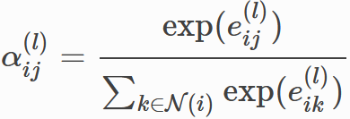
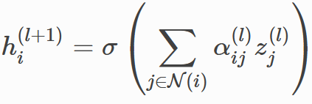
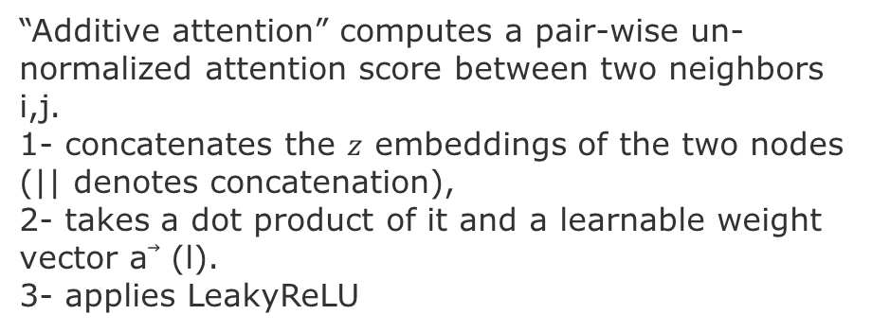
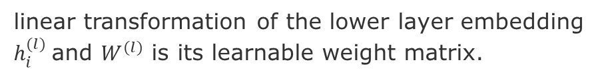
Equations in GAT [Veličković et al. 2018]
Node embedding $h_{i}^{(l+1)}$of layer $l+1$from the embeddings of layer $l$.
linear transformation of the lower layer embedding $h_{i}^{(l)}$and $W^{(l)}$ is its learnable weight matrix.
“Additive attention” computes a pair-wise un-normalized attention score between two neighbors i,j.
1- concatenates the $z$ embeddings of the two nodes (|| denotes concatenation),
2- takes a dot product of it and a learnable weight vector a⃗ (l).
3- applies LeakyReLU
Softmax normalizes the attention scores of each node incoming edge
Like GCN, the embeddings from neighbors are aggregated and scaled by the attention scores.
Source: https://docs.dgl.ai/en/0.4.x/tutorials/models/1_gnn/9_gat.html
Notes:
[Veličković et al. 2018] Veličković, P., Cucurull, G., Casanova, A., Romero, A., Lio, P., & Bengio, Y. (2017). Graph attention networks. Advances in neural information processing systems. 2018.
[Kipf & Welling 2017] Kipf, Thomas N., and Max Welling. "Semi-supervised classification with graph convolutional networks." arXiv preprint arXiv:1609.02907 (2016).
[Hamilton, Ying & Leskovec 2017] Hamilton, Will, Zhitao Ying, and Jure Leskovec. "Inductive representation learning on large graphs." Advances in neural information processing systems. 2017.

Slide 17
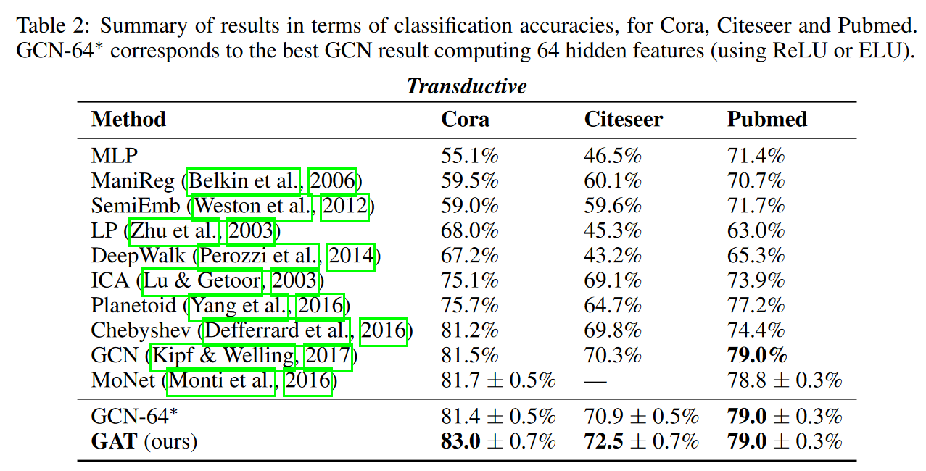
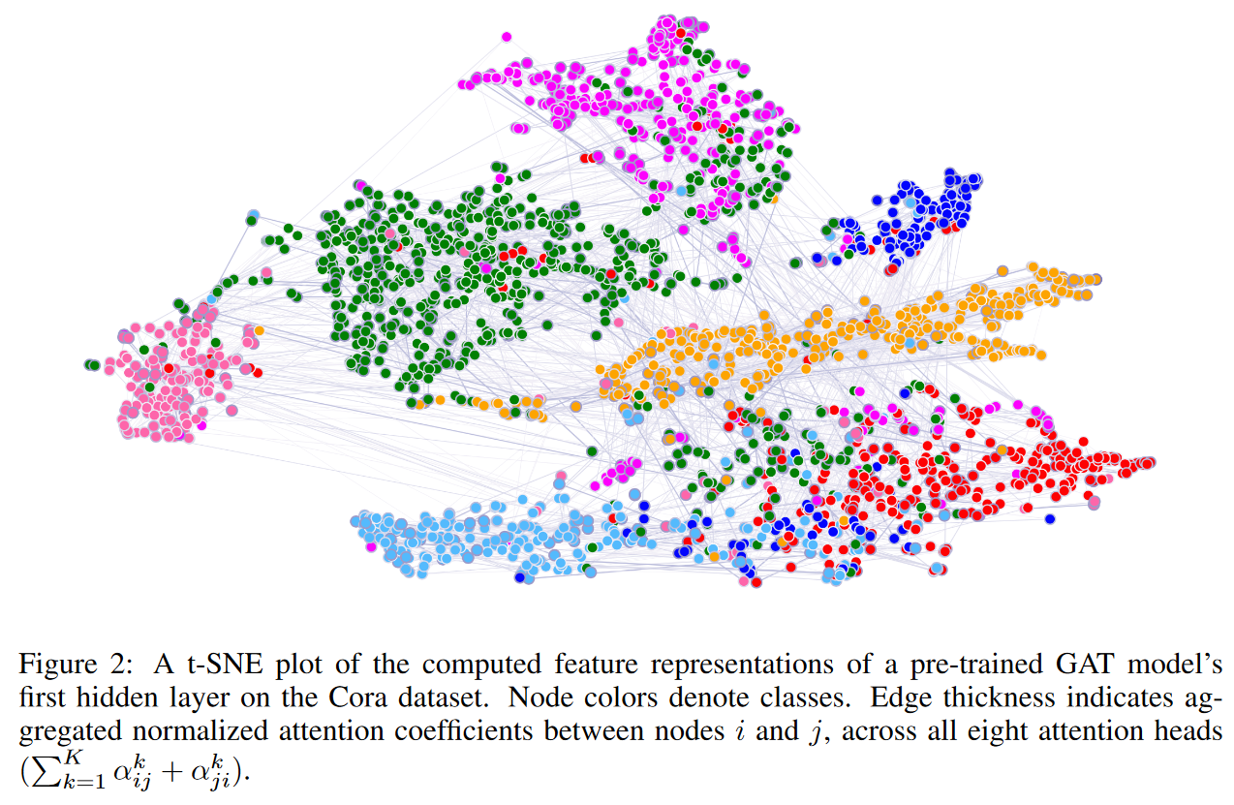
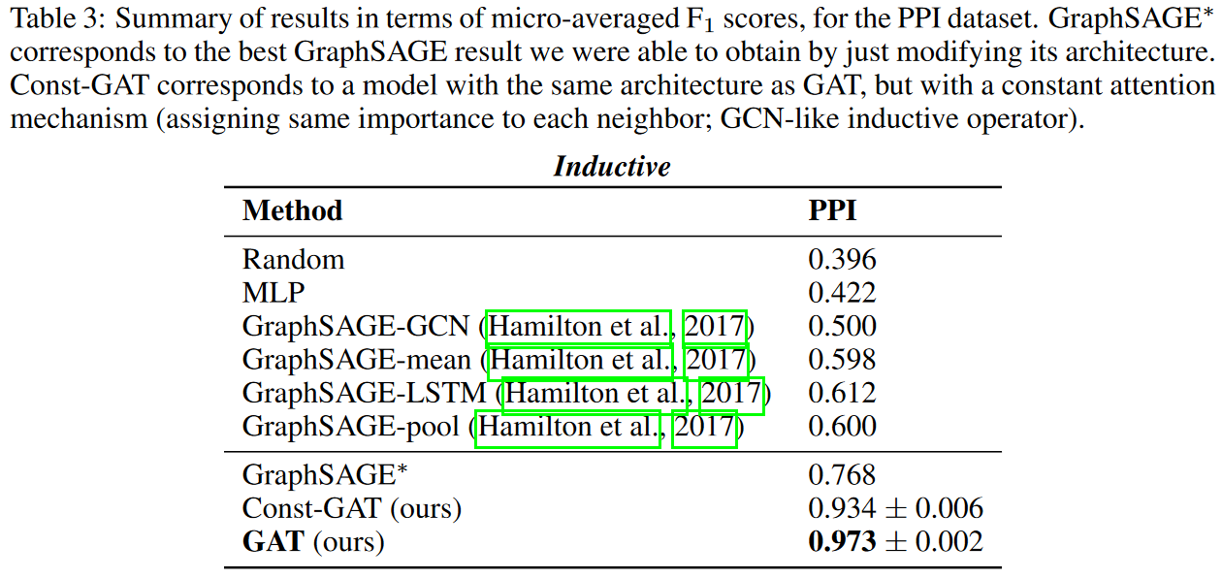
GAT [Veličković et al. 2018]
Notes:
[Veličković et al. 2018] Veličković, P., Cucurull, G., Casanova, A., Romero, A., Lio, P., & Bengio, Y. (2017). Graph attention networks. Advances in neural information processing systems. 2018.

Slide 18
Examples of source code
DGL library based on PyTorch
https://docs.dgl.ai/en/0.4.x/tutorials/models/1_gnn/9_gat.html
Implementations with TensorFlow
https://github.com/PetarV-/GAT/blob/master/models/base_gattn.py
https://github.com/Diego999/pyGAT/blob/master/layers.py
Notes:
Deep Graph Library (DGL) is a Python package built for easy implementation of graph neural network model family, on top of existing DL frameworks

Slide 19
Attention in Transformer Networks

Slide 20
Motivation for Transformer Networks
Performance: Faster, More Scalable, more Interpretable
Unlike RNN, training can be completely parallelized across sequence timesteps
Easier to train than LSTMs (RNN) does not suffer from Gradient Vanishing or Explosion
Transfer Learning works (pre-trained models can be fine-tune for new tasks)
Can be trained on unsupervised text
How it achieves it? It is Attention to the extreme
Examples of SotA in sequence-related tasks:
BERT
GPT, GPT2, GPT3
TranformerTransfo
Transformer-XL
Why is it important? Foundation for many pioneering work:
Image Transformer: increase the size of images that can be processed (https://arxiv.org/abs/1802.05751)
Self-Attention CycleGAN: Unpaired Image-to-Image Translation (https://junyanz.github.io/CycleGAN/)
AlphaStar: Grandmaster level in StarCraft II using multi-agent reinforcement learning (https://deepmind.com/blog/article/AlphaStar-Grandmaster-level-in-StarCraft-II-using-multi-agent-reinforcement-learning)
Notes:
https://junyanz.github.io/CycleGAN/
increase the size of im-ages the model can process in practice,

Slide 21
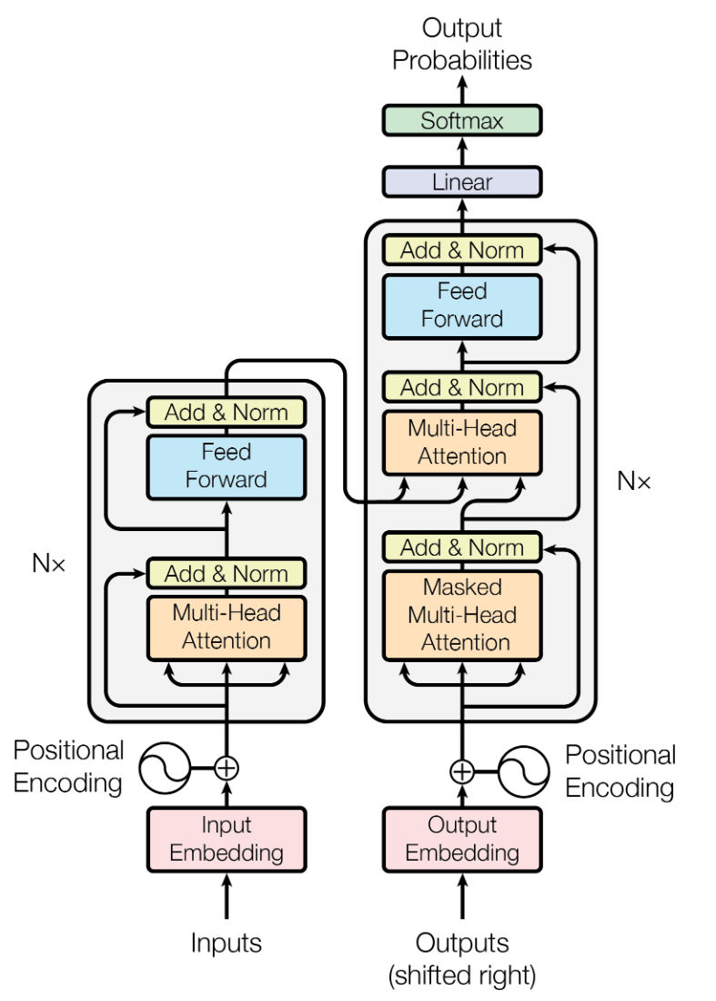
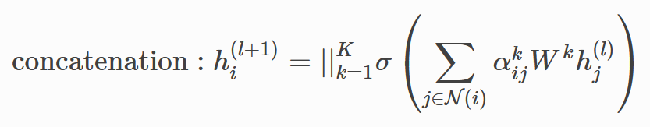
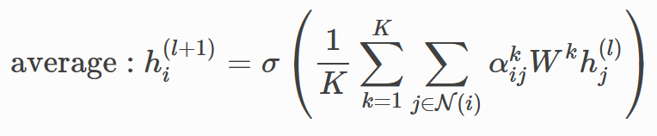
Transformer network – “Attention is all you Need” [Vaswani et al. 2017]
Decoder output:
For each word produces a distribution over the words in the dictionary
Nx This is repeated N times to combine larger groups: pairs, pairs of pairs, and so forth.
Encoder output:
an embedding
Second multi-head attention allows to map each position in the output to the position in the input
Multi-head Attention
Feed sub-vectors of words
compute the attention among all positions, i.e., each word is a query and each other word is a key.
Masked multi-head(K) attention allows to focus only on the previous words (mask future words)
Position encoding captures the sequence of the input. It uses a sin and cosine to have a continuous encoding [2]
Feeds entire sequence of words
[1]http://jalammar.github.io/images/t/transformer_decoding_2.gif
[2]https://kazemnejad.com/blog/transformer_architecture_positional_encoding/
Partially translated sentence is fed to the bottom of decoder at each decoding step [1]
Notes:
Multi-head attention helps to stabilize the learning process
The position encoding is d-dimensional vector containing the information about a specific position in a sentence. Additionally, because this encoding is not integrated into the model itself, this vector is used to equip each word with information about its position in a sentence.

Slide 22
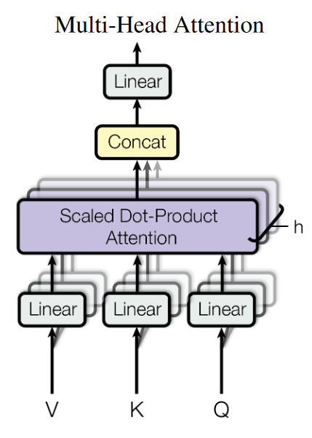
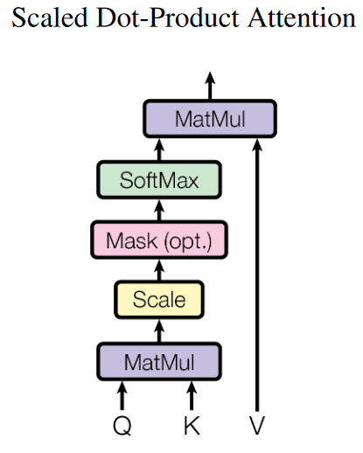
The Attention Function
An attention function is a mapping of a query and a set of key-value pairs to an output.
The Query, Keys, and Values are vectors.
The output is computed as a weighted sum of the value.
The Weight assigned to each value is computed by a compatibility function of the query with the corresponding key.

Slide 23
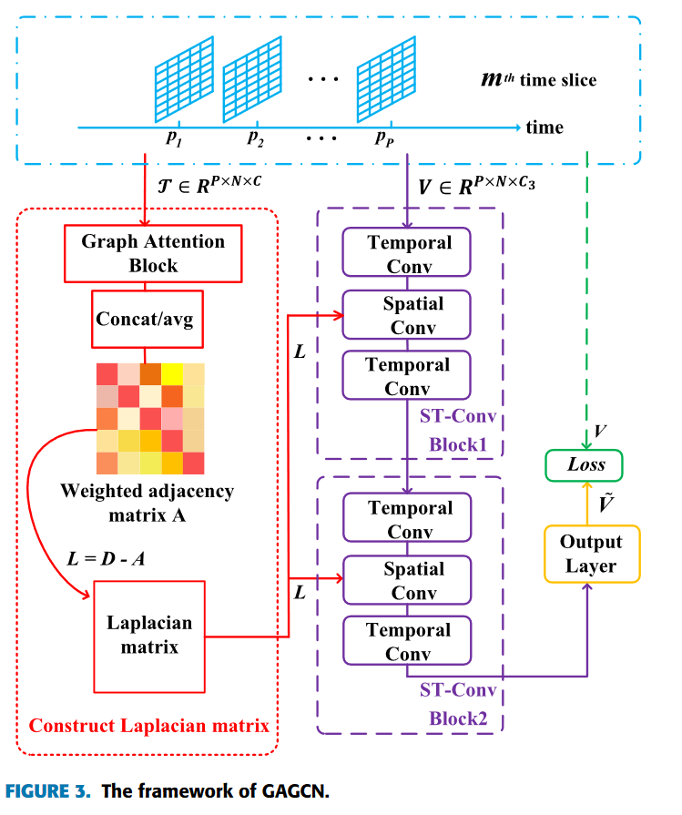
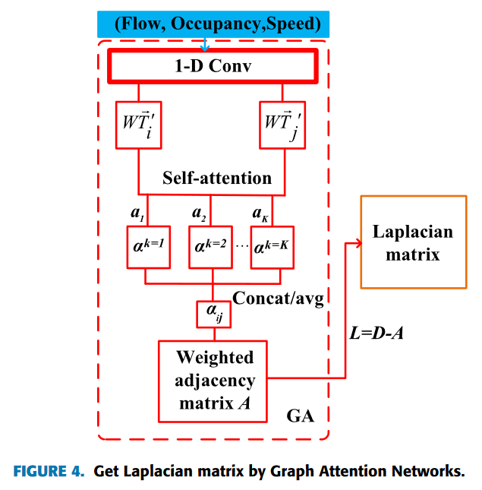
Attention GNN for Traffic-Flow Predictions
Steps
Obtain Laplacian Matrix from the Graph Attention Network
Extract Spatial features from Graph Attention and GCN
Extract Temporal Features from Gated CNNs
Tang, Cong, et al. "A general traffic flow prediction approach based on spatial-temporal graph attention." IEEE Access 8 (2020): 153731-153741.
Notes:
JOINT EXTRACTION OF SPATIAL FEATURES BY GRAPH ATTENTION NETWORKS AND GCN
3) GATED CNNs FOR EXTRACTING TEMPORAL FEATURES
4) SPATIAL-TEMPORAL CONVOLUTIONAL BLOCK

Slide 24
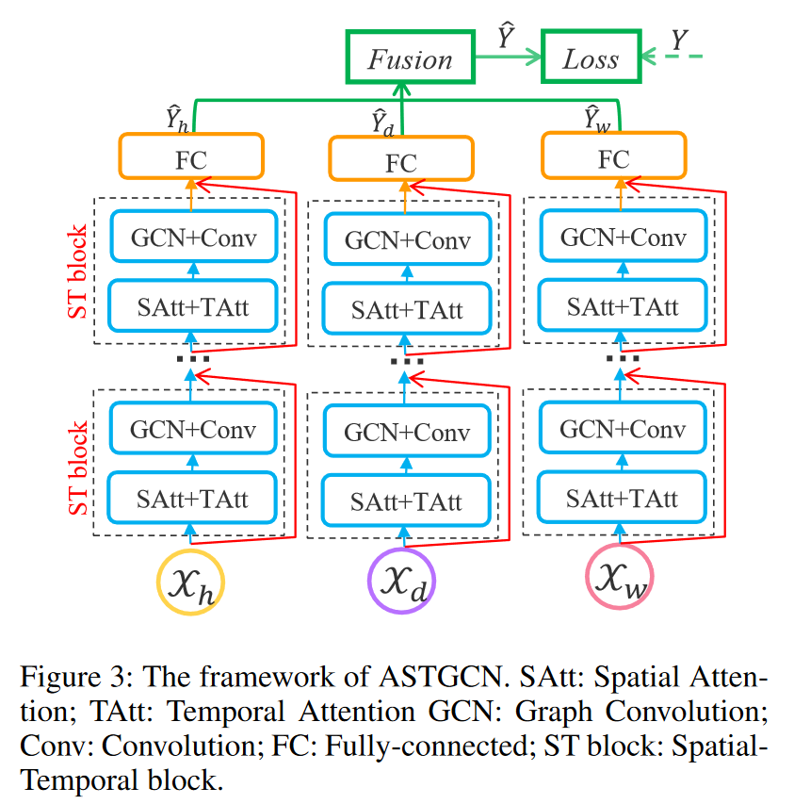
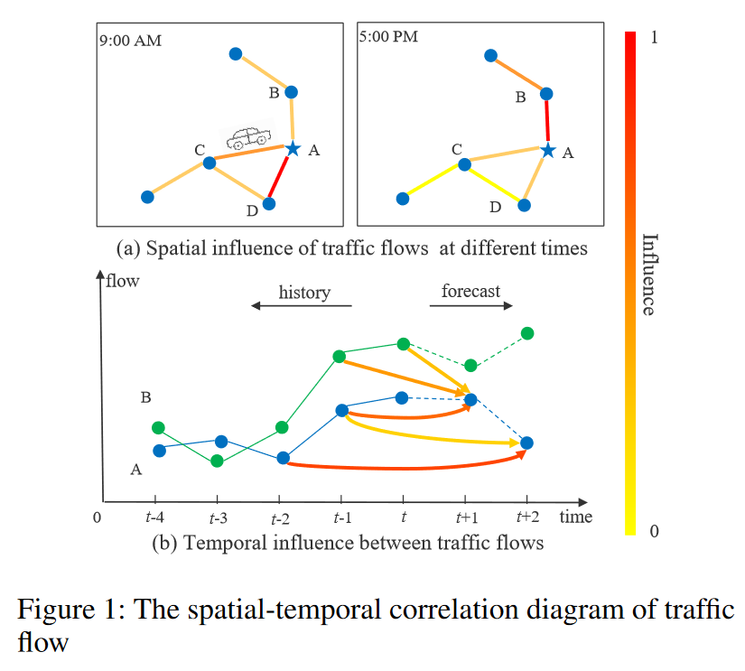
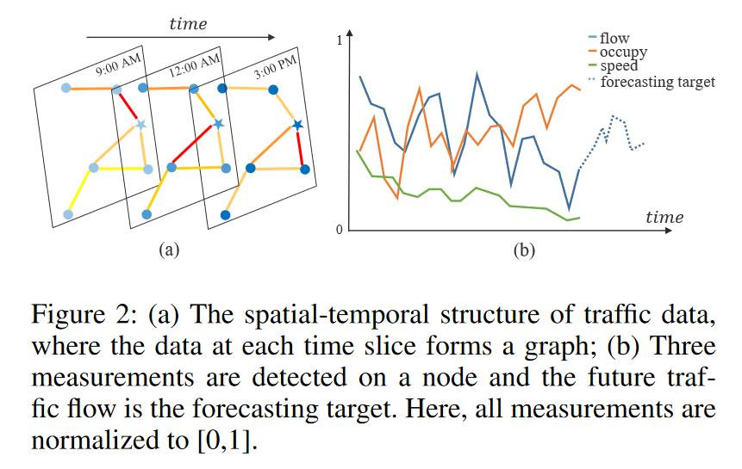
Next task (Nov. 16)
Guo, Shengnan, et al. "Attention based spatial-temporal graph convolutional networks for traffic flow forecasting." AAAI conference on AI. Vol. 33. No. 01. 2019.

Slide 25
A Few Current Challenges
Allow spatial and temporal correlations across different time slots and sensors
Fang, Yuchen, et al. "Learning All Dynamics: Traffic Forecasting via Locality-Aware Spatio Temporal Joint Transformer." IEEE Transactions on Intelligent Transportation Systems (2022).
Account for local spatial dependencies and the global inter-region dependencies in terms of traffic distributions
Zhang, Xiyue, et al. "Spatial-temporal convolutional graph attention networks for citywide traffic flow forecasting." Proceedings of the 29th ACM international conference on information & knowledge management. 2020.
Generalizable prior knowledge about traffic network structure and network architecture to model the spatial-temporal associations.
Qin, Yanjun, et al. "Memory attention enhanced graph convolution long short‐term memory network for traffic forecasting." International Journal of Intelligent Systems 37.9 (2022): 6555-6576..

Slide 26
END

